Slide 1
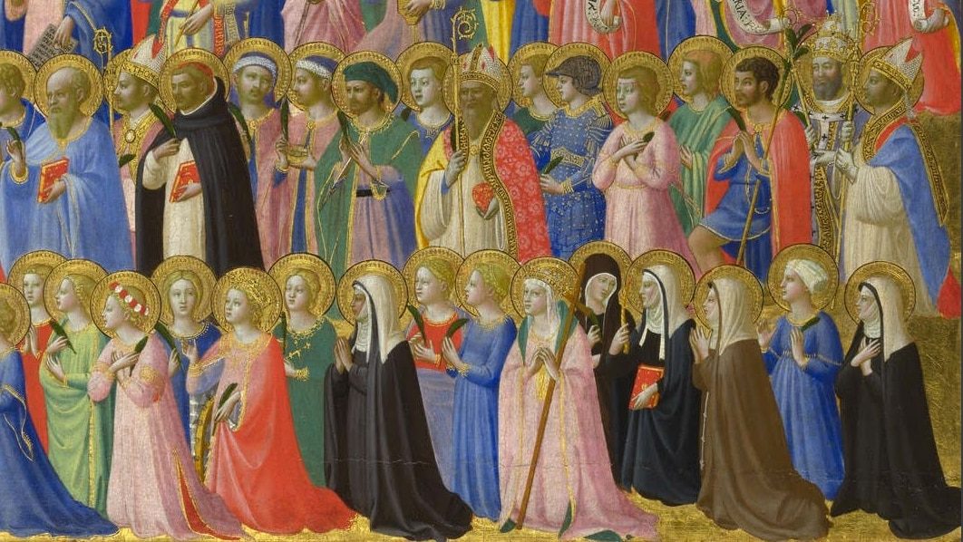
Who Is A Saint?

Slide 2
Who Is a Saint?
A saint is someone “marked” by God.

Slide 3
“In him you also, when you had heard the word of truth, the gospel of your salvation, and had believed in him, were marked with the seal of the promised Holy Spirit; ” (Ephesians 11:13)

Slide 4
Who Is a Saint?
A saint is “marked” by God.
A saint perseveres to the end.

Slide 5
“Blessed are you who are poor, for yours is the kingdom of God.” (Luke 6:20)

Slide 6
Who Is a Saint?
A saint is “marked” by God.
A saint perseveres to the end.
A saint will receive the kingdom.

Slide 7
“But the holy ones of the Most High shall receive the kingdom and possess the kingdom forever—forever and ever.” (Daniel 7:18)

Slide 8
Who Is a Saint?
YOU are a saint.

Slide 9
Become the saint God has declared you to be!
Live in the reality of your baptism.
Live in perseverance to the end.
Live in hope for the kingdom.

