Slide 1
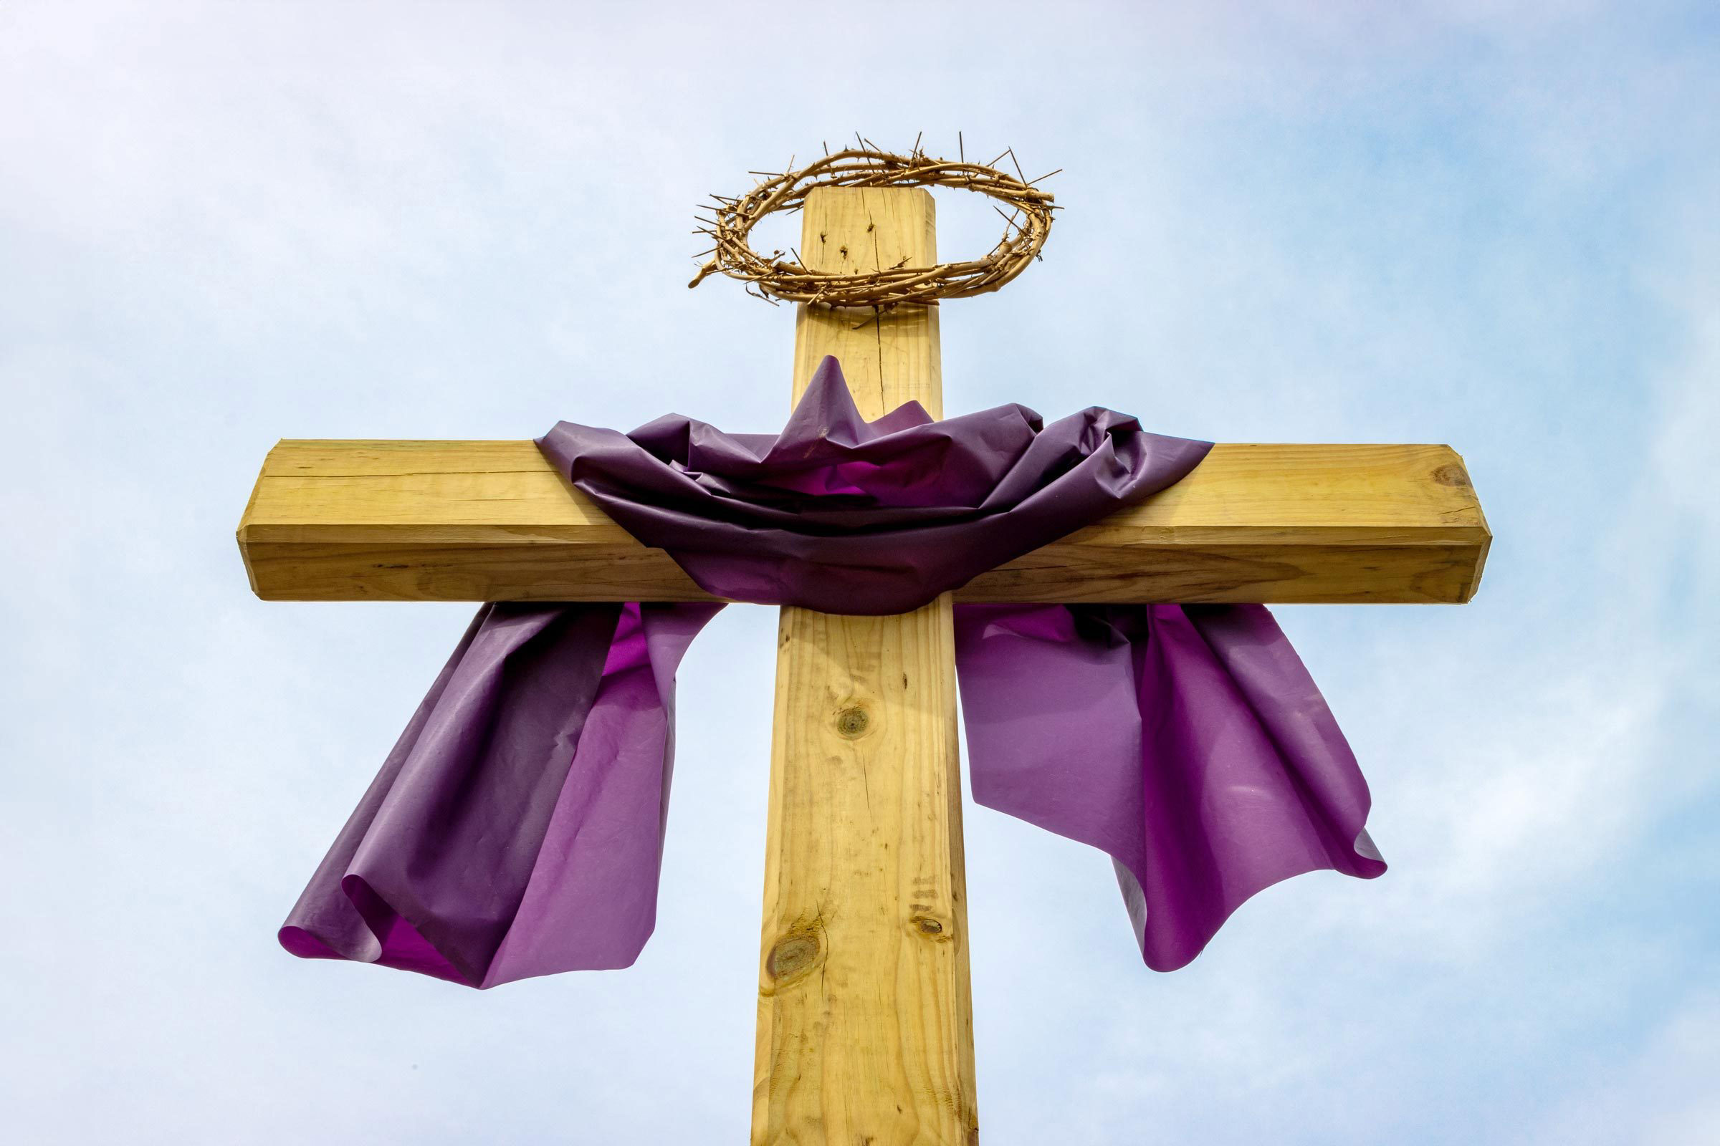
Keeping a Holy Lent #4
Scripture Reading

Slide 2
Recap
Fasting—something good, something noticeable, something that will pinch.
Almsgiving—a specific form of fasting targeting wealth.
Prayer—a focused, intentional conversation with God

Slide 3
Scripture Reading
A fourth traditional Lenten observance.
The discipline of listening.

Slide 4
What is Scripture Reading?
Scripture Reading is not. . . .
A magic eight ball.
An academic activity

Slide 5
What is Scripture Reading?
Scriptrure Reading is. . .
The ordinary way of listening for God’s voice.
Ordinary and extraordinary

Slide 6
What is the Point?
Fasting and Almsgiving are about emptying.
Prayer is about filling.

Slide 7
What is the Point?
Detaching and (Re-)Attaching
Friendship with God
Speaking (prayer) and listening (scripture reading)

Slide 8
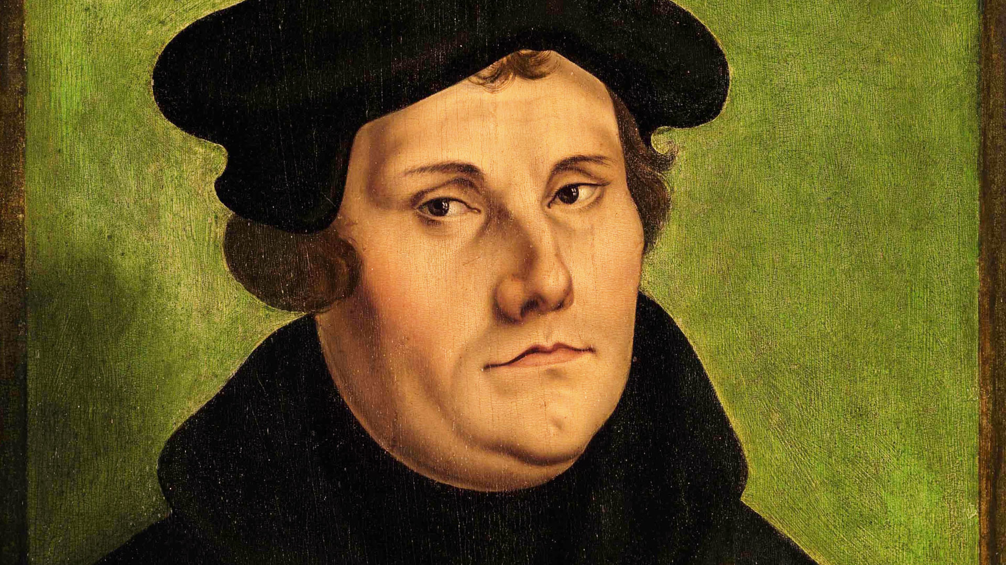
Luther on Holy Scripture
“Though I am an old doctor of divinity, to this day I have not got beyond the children’s learning – the Ten Commandments, the Creed, and the Lord’s Prayer;

Slide 9
Luther on Holy Scripture
“and these I understand not so well as I should, though I study them daily, praying, with my son John and my daughter Magdalene”

Slide 10
Luther on Holy Scripture
“He who loses sight of the Word of God, falls into despair; the voice of heaven no longer sustains him; he follows only the disorderly tendency of his heart, and of world vanity, which lead him on to his destruction”

Slide 11
How to Read
Read in the community of faith.
Read as families.
Read in secret.

Slide 12
How to Read
Read your Bible. Pray every day and you’ll grow grow grow!
“I hear not Paul, Peter, or a man speak, but God himself.”

